Slide 1
Unit 1: Software Quality Assurance
Cost of Quality (COQ)

Slide 2
Cost of Quality (COQ)
Cost of Quality can be termed as the process that measures and determines where and how organizations' resources are utilized to maintain quality and prevent poor outputs. It can be regarded as a method of process improvement and quality assurance and prevents internal and external audit failures.

Slide 3
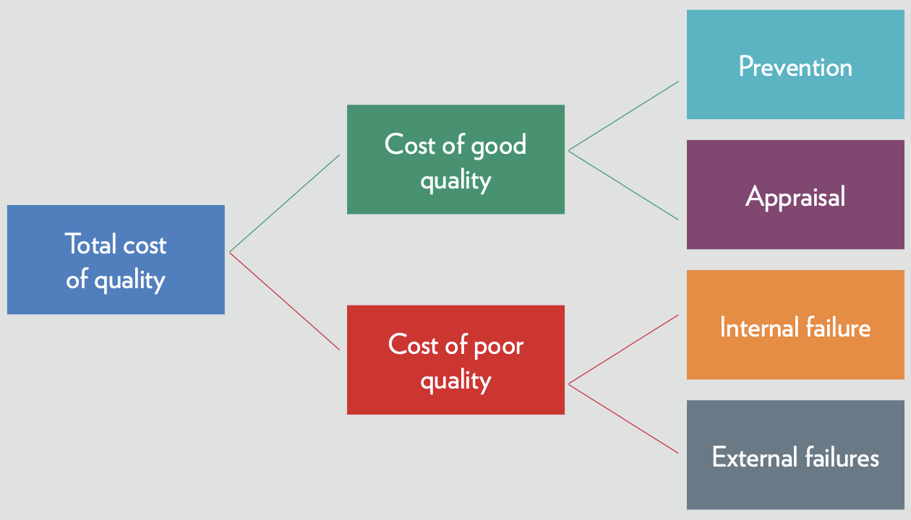
Cost of Quality (COQ)

Slide 4
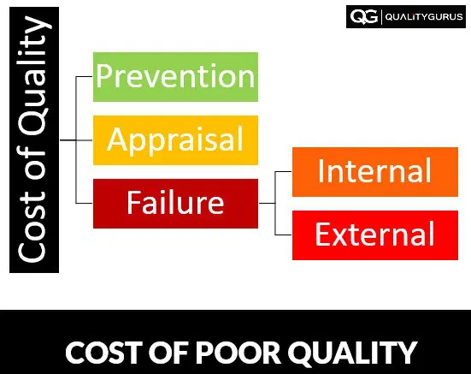
Unit 1: Software Quality Assurance

Slide 5
Prevention Costs:
1. Prevention Costs:
Prevention costs are the costs of all activities that are designed to prevent poor quality from arising in products or services. The examples of the prevention costs include:
Quality planning
Education and training
Conducting design reviews
Supplier reviews and selection
Quality system audits
Process planning and control
Product modifications
Equipment upgrades

Slide 6
2. Appraisal Costs:
Appraisal costs are costs that are incurred to ensure the conformance to quality standards and performance requirements. The examples of the appraisal costs include:
Test and inspection (receiving, in-process and final)
Supplier acceptance sampling
Product Audits
Calibration

Slide 7
3. Internal Failure Costs:
Internal Failure Costs are the costs that are associated with defects found within the organization before after the customer receives the product or service. The examples of the internal failure costs include:
In-process scrap and rework
Troubleshooting and repairing
Design changes
Inventory required to support poor process yields and rejected lots
Re-inspection / retest of reworked items

Slide 8
4. External Failure Costs:
External Failure Costs are the costs that are associated with defects found after the customer receives the product or service. The examples of the external failure costs include:
Sales returns and allowances
Replacing defective products
Service level agreement penalties
Complaint handling
Field service labor and parts costs incurred due to warranty obligations
Product recalls / Legal claims
Lost customers and opportunities
Downgrading
Processing of customer complaints

Slide 9
Classification of the Cost of Quality - Some Examples:
Let's look at some examples to understand the classification we discussed above.
1. Cost of getting company certified to ISO 9001
This will be a prevention cost, as our intention is to establish a system to avoid problems from happening in the first place.
2. The cost of quality-related training
This will also be a prevention cost, as the training is being delivered to avoid or prevent poor quality.
3. Review of drawings
This is an appraisal cost, as in this case, you are checking if the drawings have been made correctly.
4. Preparation of quality management system and inspection procedures
This will be a prevention cost, as the quality management system and inspection procedures help us avoid quality problems.
5. Product recall and warranty repairs
This will obviously be an external failure cost.
6. Defects found by customers after receiving the product
Once again, this will be an external failure cost.
7. Inspection and re-inspection of the repaired product
These will be internal failure costs.

Slide 10
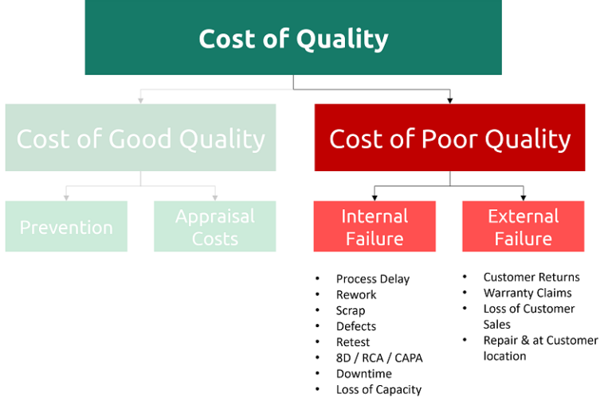
Understanding the Cost of Failure

Slide 11
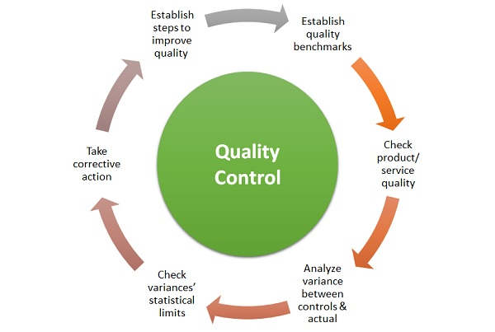
Quality control

Slide 12

Reliability vs. Scalability

Slide 13
Reliability vs. Scalability
Two key factors stand out while designing and building efficient systems: reliability and scalability. Imagine you're constructing a bridge. Reliability ensures that once it's built, it won't collapse unexpectedly. Scalability, on the other hand, is like designing a bridge that can handle not just the current traffic but also future increases in vehicles without causing gridlock.

Slide 14
What is Reliability?
Reliability refers to the ability of a system, component, or process to perform its specified functions under stated conditions for a defined period of time. In simpler terms, it's about the consistency and dependability of a system in delivering its intended functionality without failure.
Factors influencing System Reliability

Slide 15
Redundancy:
The use of redundancy, such as duplicate components or backup systems, can improve system reliability by providing fallback mechanisms in case of component failures.
Redundancy can be implemented at various levels, including hardware redundancy, software redundancy, and data redundancy.
System Architecture:
The design and architecture of the system play a crucial role in determining its reliability.
Well-designed architectures with clear separation of concerns, modularization, fault isolation, and graceful degradation mechanisms tend to be more reliable than monolithic or tightly coupled architectures.
Maintenance Practices:
Regular maintenance, inspection, and preventive measures can help identify and address potential issues before they lead to system failures.
Proper maintenance practices, including software updates, hardware replacements, and system checks, can improve system reliability and prolong its lifespan.

Slide 16
What is Scalability?
Scalability refers to the ability of a system, network, or application to handle increasing amounts of work or data without compromising performance, responsiveness, or quality of service. In simpler terms, it's about a system's ability to grow and adapt to meet changing demands and requirements effectively.

Slide 17
Factors Influencing System Scalability
Several factors influence the scalability of a system, determining its ability to handle increasing workloads or user demands effectively while maintaining performance, reliability, and efficiency. These factors can vary depending on the nature of the system, its architecture, and the operating environment. Here are some key factors that influence system scalability:
Architecture Design:
Well-designed architectures, such as micro services, distributed systems, and modular architectures, tend to be more scalable than monolithic or tightly coupled architectures.
Resource Provisioning:
Scalable systems should have access to sufficient resources to handle increasing workload demands effectively.
Horizontal and Vertical Scaling:
Horizontal scaling improves system capacity and fault tolerance by parallelizing tasks and load balancing.
Vertical scaling (scale up) involves increasing the capacity of existing resources, such as upgrading hardware components or increasing resource allocations.

Slide 18
Factors Influencing System Scalability
Data Management:
Efficient data management practices are crucial for system scalability, especially in systems dealing with large volumes of data. Factors such as data partitioning, shading, replication, and indexing influence the scalability of data storage, retrieval, and processing.
Concurrency and Parallelism:
Concurrency and parallelism techniques, such as multi-threading, asynchronous processing, and distributed computing, enable systems to handle concurrent requests and process tasks concurrently.
Performance Optimization:
Performance optimization techniques, such as caching, prefetching, lazy loading, and query optimization, improve system responsiveness and throughput, thereby enhancing scalability. nd user experience.

